Slide 1






PIZZA SALES
ANALYSIS

Slide 2



List of questions
Retrieve the total number of orders placed.
Calculate the total revenue generated from pizza sales.
Identify the highest-priced pizza.
Identify the most common pizza size ordered.
List the top 5 most ordered pizza types along with their quantities.

Slide 3
List of questions
Join the necessary tables to find the total quantity of each pizza category ordered.
Determine the distribution of orders by hour of the day.
Join relevant tables to find the category-wise distribution of pizzas.
Group the orders by date and calculate the average number of pizzas ordered per day.
Determine the top 3 most ordered pizza types based on revenue.

Slide 4
List of questions
Calculate the percentage contribution of each pizza type to total revenue.
Analyze the cumulative revenue generated over time.
Determine the top 3 most ordered pizza types based on revenue for each pizza category.

Slide 5


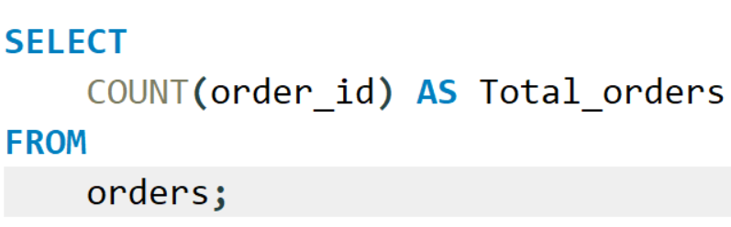
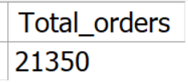

Retrieve the total number of orders placed.

Slide 6
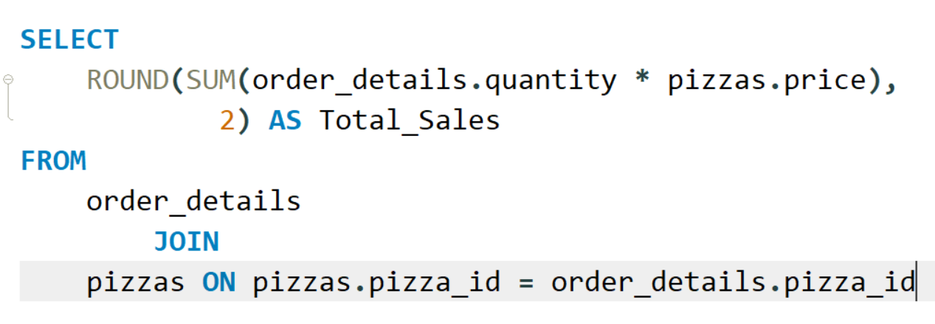


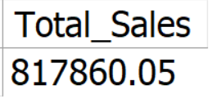
Calculate the total revenue generated from pizza sales.

Slide 7
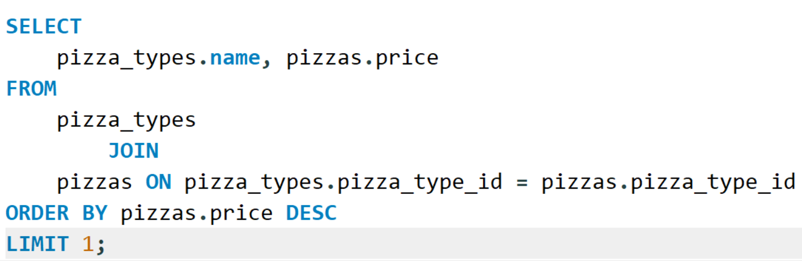


Identify the highest-priced pizza.

Slide 8
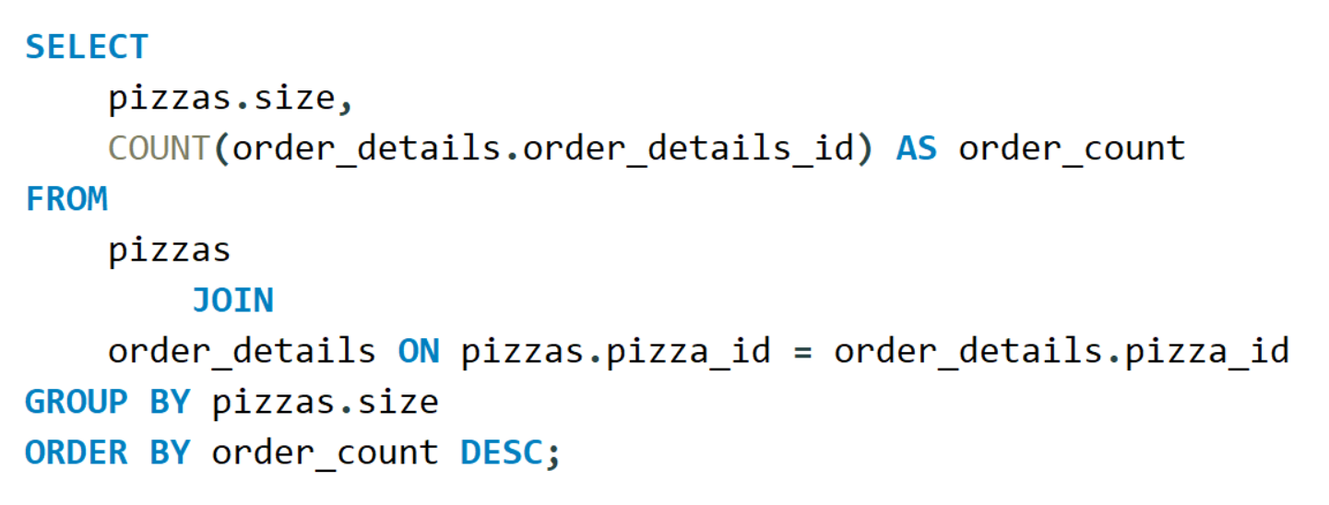
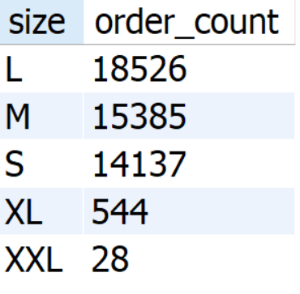
Identify the most common pizza size ordered.

Slide 9
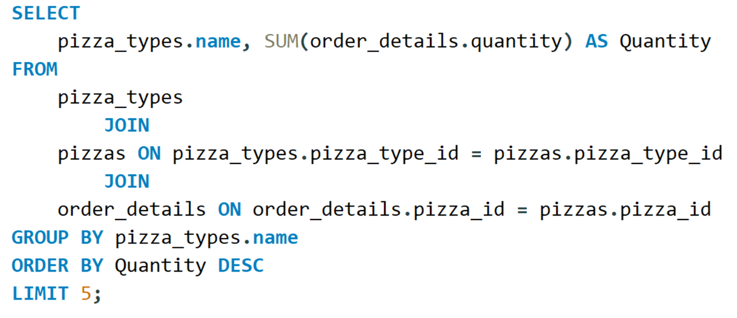


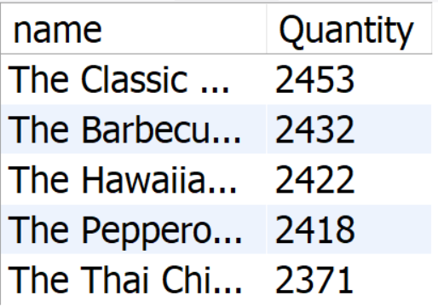
List the top 5 most ordered pizza types along with their quantities.

Slide 10
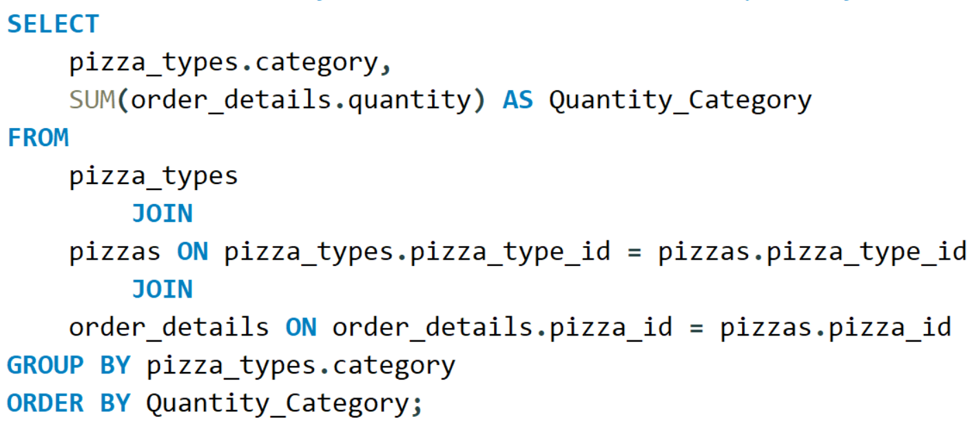
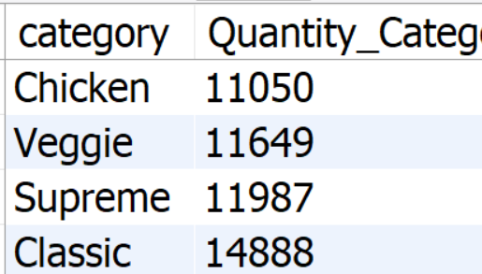
Join the necessary tables to find the total quantity of each pizza category ordered.

Slide 11
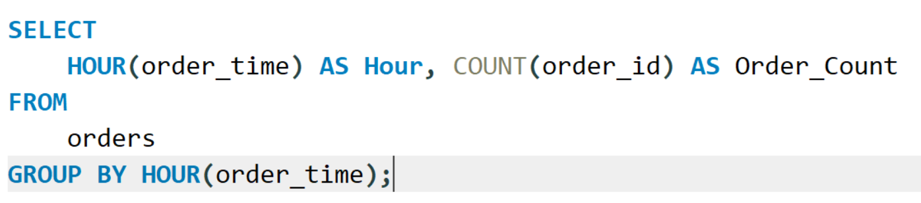
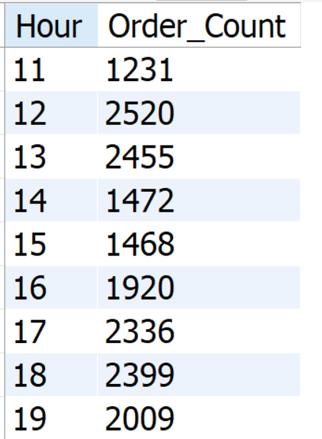
Determine the distribution of orders by hour of the day.

Slide 12
Identify the highest-priced pizza.

Slide 13
Identify the most common pizza size ordered.

Slide 14
List the top 5 most ordered pizza types along with their quantities.

Slide 15
Join the necessary tables to find the total quantity of each pizza category ordered.

Slide 16
Determine the distribution of orders by hour of the day.

Slide 17
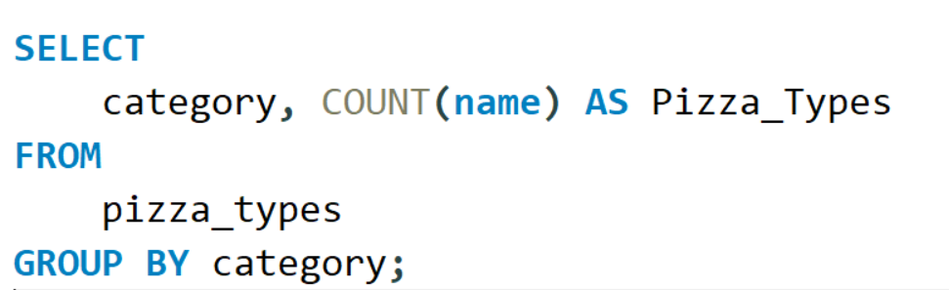
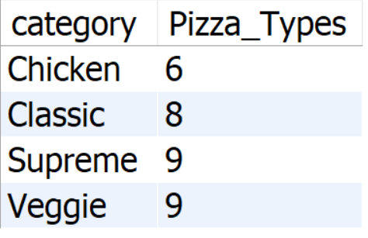
Join relevant tables to find the category-wise distribution of pizzas.

Slide 18
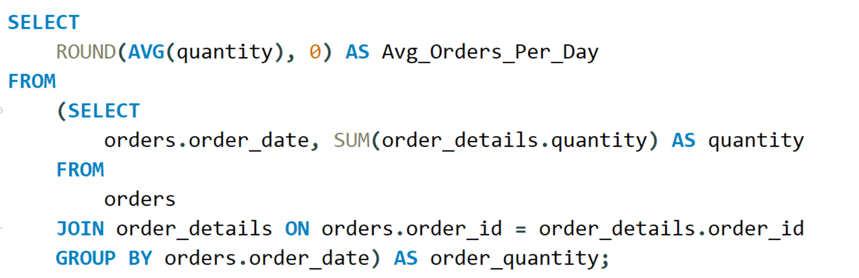
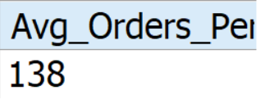
Group the orders by date and calculate the average number of pizzas ordered per day.

Slide 19
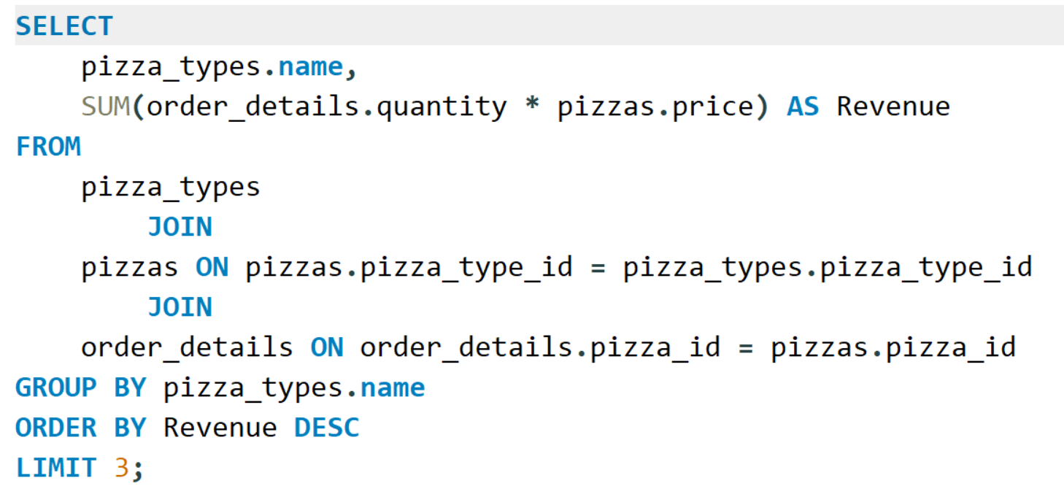
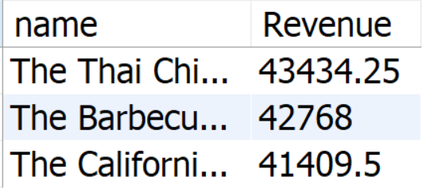
Determine the top 3 most ordered pizza types based on revenue.

Slide 20
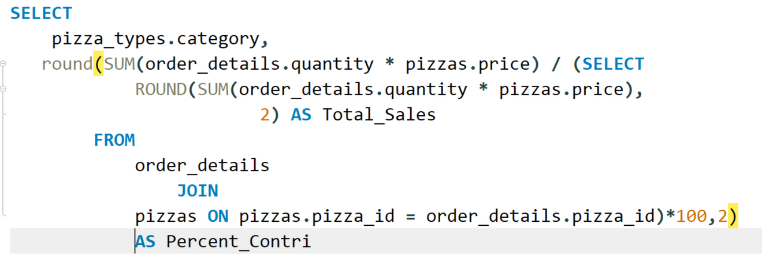
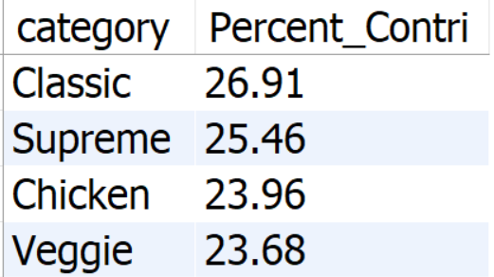
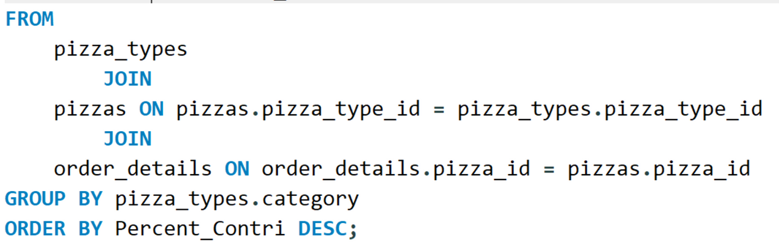
Calculate the percentage contribution of each pizza type to total revenue.

Slide 21
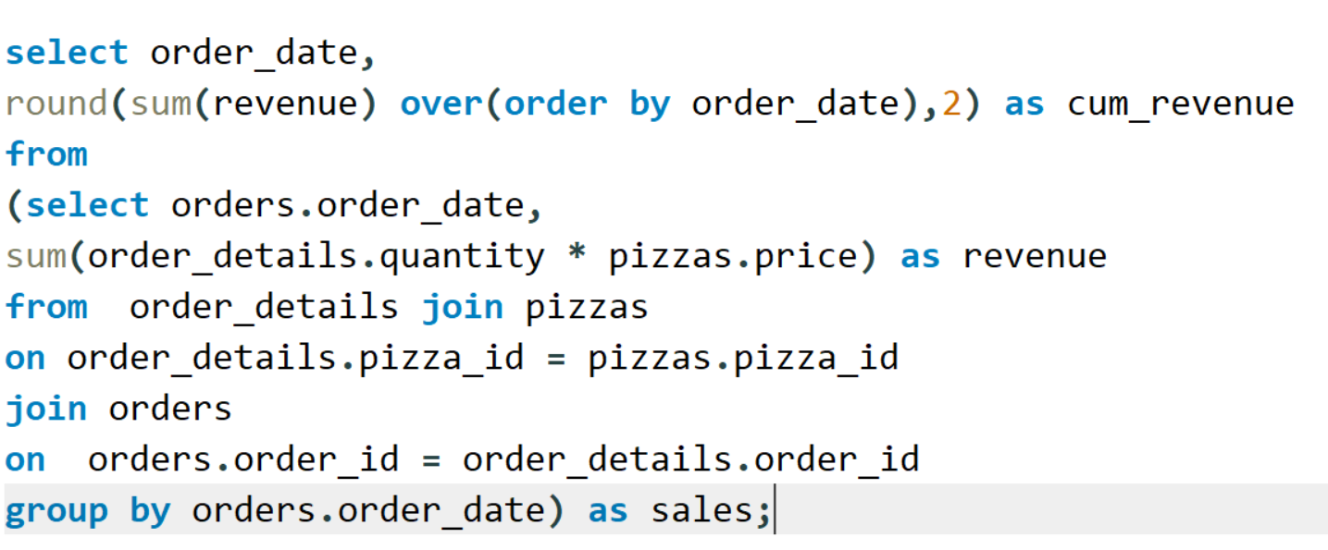
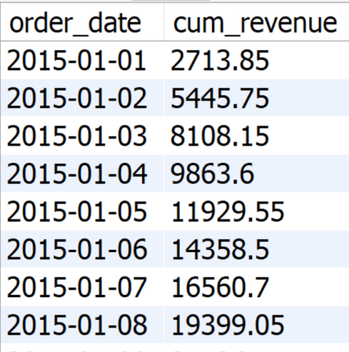
Analyze the cumulative revenue generated over time.

Slide 22
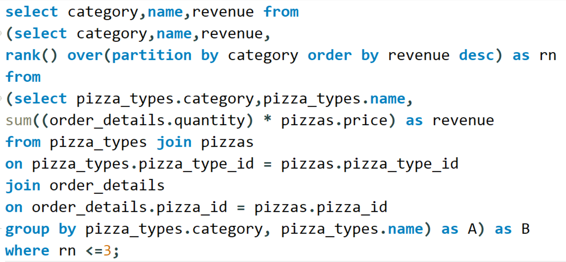
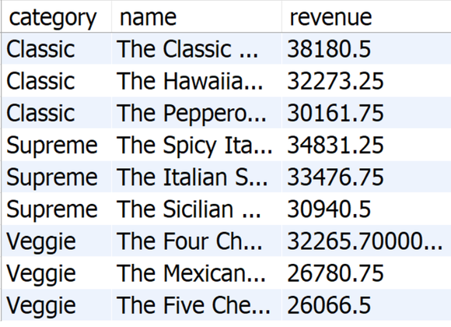
Determine the top 3 most ordered pizza types based on revenue for each pizza category.

Slide 23

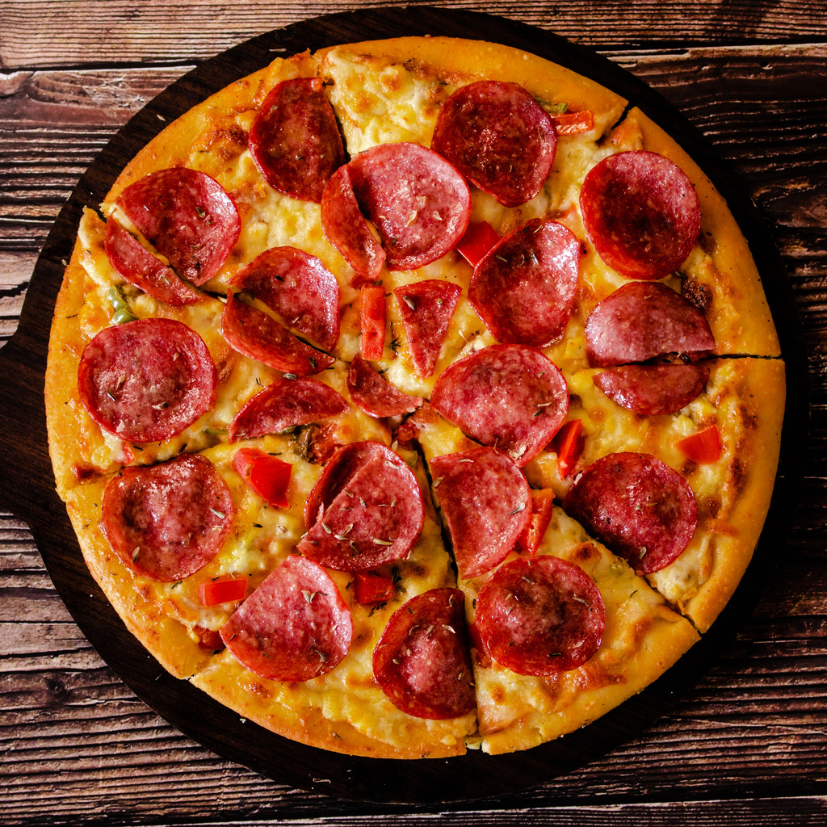
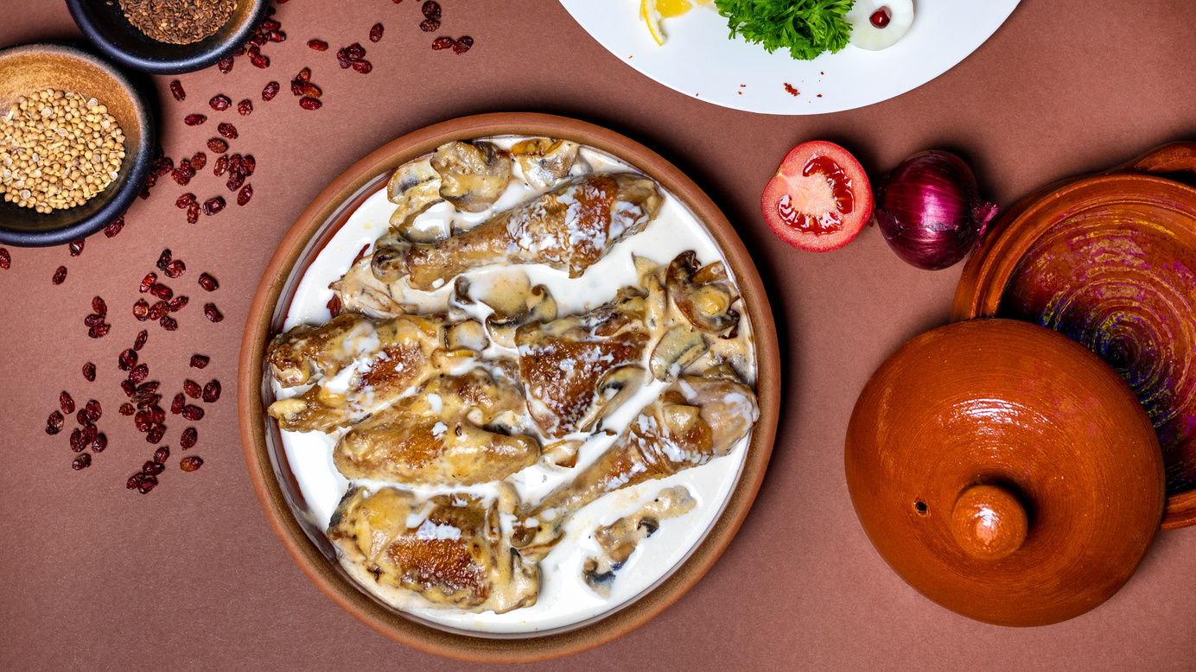

Variations
Pizza Margherita
Pepperoni Pizza
BBQ Chicken Pizza
Hawaiian Pizza

Slide 24
Thank You

